Slide 1
I coders
Naga Nidesh Babu Doppalapudi
MD Moqbull Hussen
Sameed Shaik
Tarun Teja Kasturi

Slide 2
Home AI – Lunch Suggestions App
One of the most difficult decisions we make on a day-to-day basis, is deciding what to eat for lunch.
As creatures of habit, the truth is that our lunch options are fairly limited.
So just by asking Alexa for a type of cuisine, the time to figure out where to eat can be significantly reduced!
We used Amazon Web Services, Lambda, Alexa voice services to develop it.

Slide 3
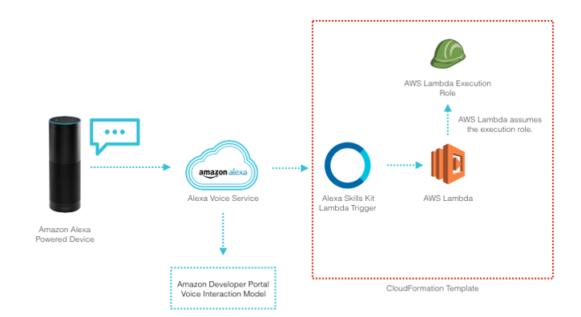
Technology Flow

Slide 4
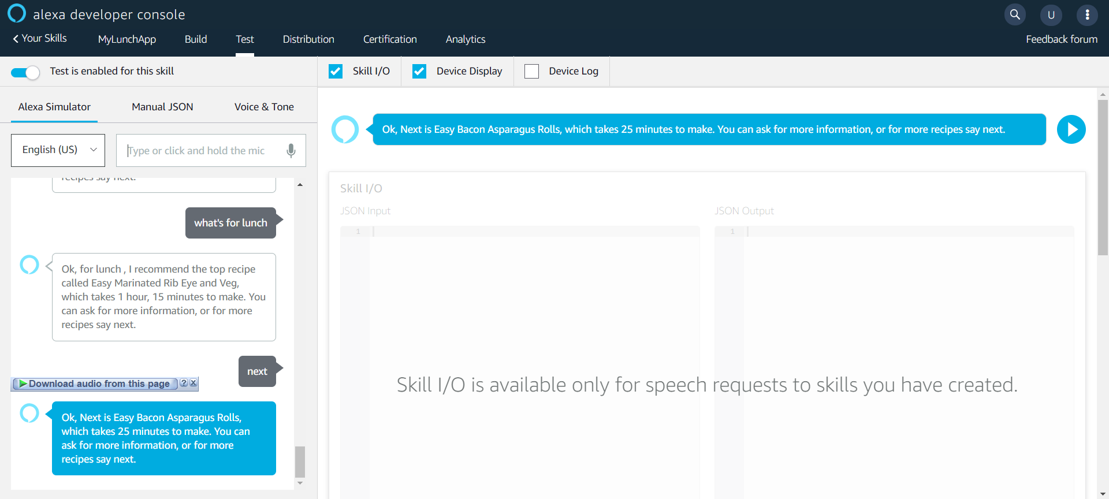
Ask Alexa – “Whats for lunch”

Slide 5
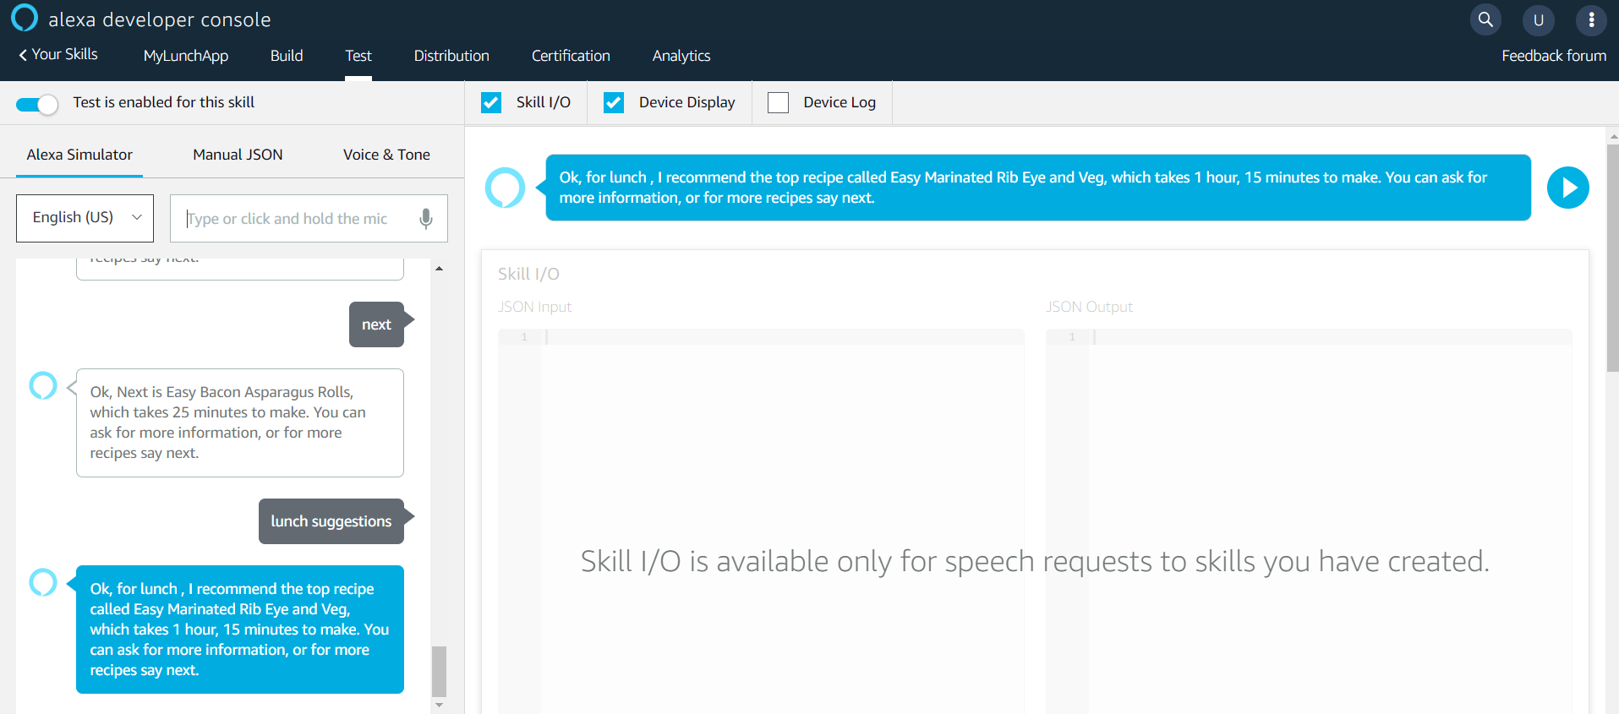
Ask Alexa – “Next”

